Slide 1
Trash Reporting System
Open Source GIS
University of Applied Sciences

Slide 2
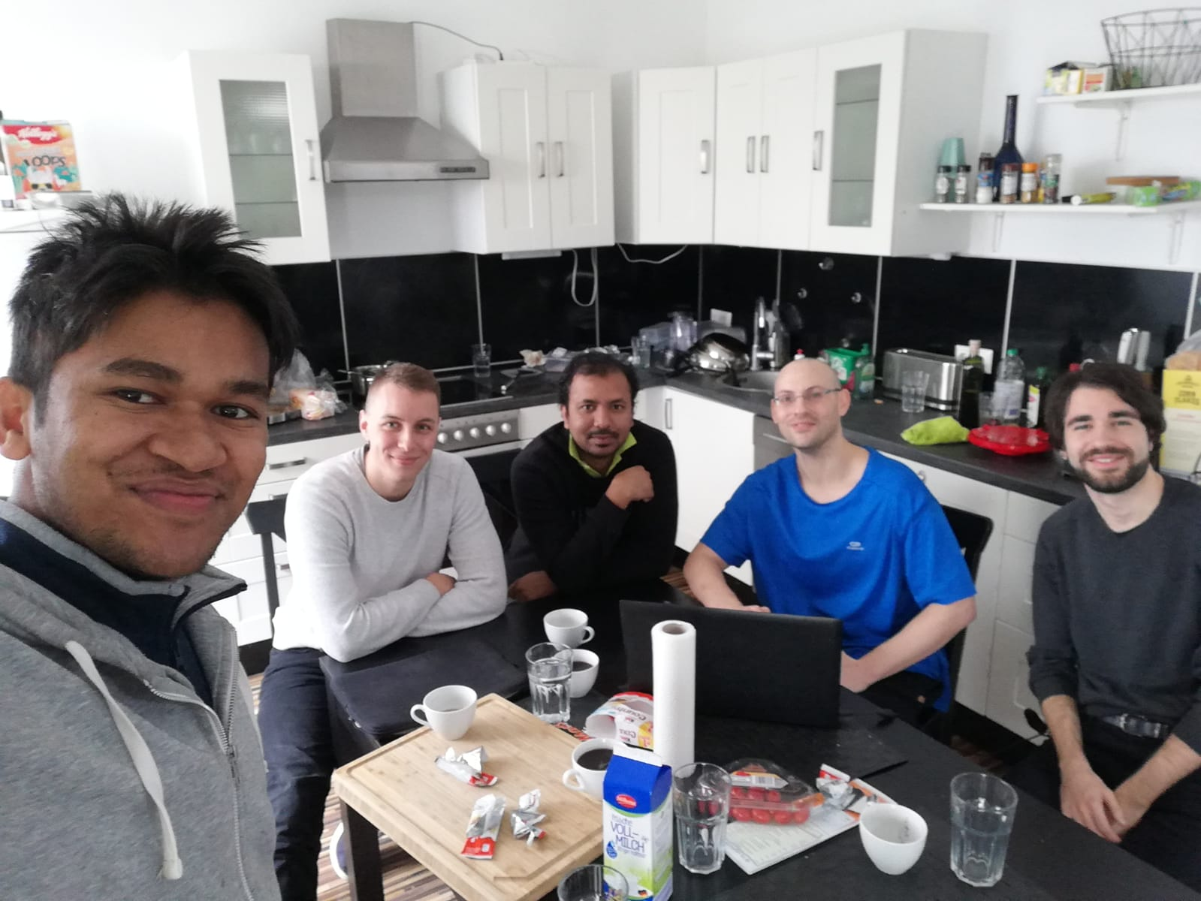
Oliver Hennhöfer
Yair Preiss
Md Raqibul Islam
Shaiful Islam
Kristóf

Slide 3
Doom - Team Members
Yair Preiss - Israel, UPV student on 3rd semester.
BSC in Geoinformatics & Logistics.
Experience
SQL Development - functions (postgres/postgis), procedures (SQL-Server), triggers..
BI Development - Forms and stats with SQL
GIS programming - general & automatization with python (ESRI)
Like GIS in all its forms - mobile/web/desktop, and in particular when it's free (QGIS...)
Favorite language: Python
For DB: SQL --> PostGIS
For web server-side: Flask/Django
Favorite OS: Linux (Ubuntu)

Slide 4
Doom - Team Members
Oliver Hennhöfer - Germany, Geomatics Msc. 3rd semester
BSC in Geoinformation Management (Geomarketing)
Experiences
Java Development - minor java applications, software system as course assignment
Web Development - projects with JavaScript, HTML, CSS (Bootstrap, Leaflet, jQuery, …)
Statistical Analysis with R - statistics tutor (with R)
Qt/Qml Development - Mobile Application as course assignment
Database Query Language - basic skills in SQL
GIS Programming - basic skills in python (ArcPy)
GIS Analysis - basic skills in spatial analysis with GIS (ArcGIS, …)
Favorite language: R and Java
Favorite OS: Windows

Slide 5
Doom - Team Members
Shaiful Islam
BSC in Computer Science And Engineering (CSE)
Msc in GeoInformatics at HsKA
Experience
Programming:Java, Groovy, Python,SQL and CQL
Databases and Database Modeling: SQL databases (Mysql, Oracle and PostgreSQL with PostGIS & MS
SQL Server) and NoSQL databases(like MongoDB, Cassandra and
Redis)
Development Framework: Grails, Spring data REST, MVC & Boot and different JavaScript based frameworks
Web programming: CSS, XML, JSON, JavaScript & JQuery
Open source GIS applications: Google APIs and UDig (WMS, WFS, PostGIS), GeoServer,OpenStreet Map (OSMOSIS), QGIS
Favorite OS: Windows and Linux

Slide 6
Doom - Team Members
Kristóf Győri - Hungary, geography MSc, geoinformatics specialization 3rd semester
BSC in geography, geoinformatics specialization
Experiences
GIS Analysis in numerous topics with ArcGIS, QuantumGIS, GrassGIS, MapInfo
Spatial Analysis, working with aerial and satellite imagery (classification, orthorectification)
Programming: C, Python, HTML, Java and Javascript in progress
Work experience in land surveying (BSc Internship and studies)
Favourite language: HTML and Python
Favourite OS: Windows

Slide 7
Doom - Team Members
Md Raqibul Islam- Bangladesh, Geomatics Msc
Bachelor in Urban Planning
Experience
Web Programming- Class project using HTML, CSS, JavaScript (Bootstrap, AngularJs)
Database- Postgres and SQL
GIS- Basic skill in Python (Arcpy,), ArcGIS Server, ArcGIS Portal.
OS- Windows, Ubuntu

Slide 8
Developing a web/mobile--GIS app --> Trash Reporting System.
Users registration, login/renew password to prevent spamming
The data is arriving from the users, to try to avoid spams users shall be registered. There is no legality issues, but some intentionally/unintentionally wrong data may get input, hence an elegant solution would be nice to find (maybe upload an image of the trash and some background of the street in the image so the municipality can see it's the real area, ofc maybe it's not updated…)
.

Slide 9
Developing a web/mobile--GIS app --> Trash Reporting System.
2. Users fill in the form with their location and choose the trash type (paper/metal/plastic...)
In the form the coordinates will be obtained automatically with HTML5+JS code. For mobile the code will be more accurate than for a Laptop.
For the trash type field, the user will be able to select among the trash types trash are common for Karlsruhe for now.

Slide 10
Developing a web/mobile--GIS app --> Trash Reporting System.
3. Presented map with points of trash
The users can choose a desired basemap like osm or sat with the projection: EPSG:4839 = ETRS89 / EPSG:3857 = WGS84
For this moment it's a beta version so it will be designated only for KA first.
The map will contain the necessary standard tools:
Zoom, pan, north arrow, scale bar, search functions (still have not decided),
coordinates, map image, legend, layers (base+points),
feature information (trash type and time of reporting), metadata (still have not decided)

Slide 11
Developing a web/mobile--GIS app --> Trash Reporting System.
4. Statistics of trash in Karlsruhe
users can assess the quality of the trash removal service given by the municipality (it will be presented how much time the point is on the map).
The municipality/service provider is capable of planning and analyzing its work routine. Which and where trash cans are needed. Better service for the users, fuel consumption is moderated by the service provider with optimal routing/work organization due to more available info. The users can observe at stats such as number of points, number of points per area or quarter, most common trash type, less common trash type, avg. time of points on map until removed, longest time, shortest time --> to get an analysis service quality by area.

Slide 12

How did this born?
Running daily allover KA,
and sometimes being exposed
to trash on the street
2. Insufficient amount of
trash cans at the different
campuses

Slide 13
Tools & system architecture
Server side - Flask/Django because it's a quick and simple framework and it's suitable for small projects and it's trendy in the GIS world (Geodjango).
Flask is simpler for a small project, but if additional functions will be required in the future, it would be better to use Django, so we should decide on this.

Slide 14
Tools & system architecture
DB – PostGIS because in the future more geospatial analysis can be done by the users/developers/trash service for an optimal trash cans location/type/routing etc… moreover it is actually a "standard" in the GIS world, so even though some other DB systems are available such as sql server and oracle offer this possibility, we should stick with the more common, and open source free tool.
There will be a table for the users with their hashed passwords so they could login and renew their passwords.
Another table will be dedicated to the data the users entered with a time column. It is designated only for KA at that moment thus a normal time column is sufficient (no additional timezones)

Slide 15
Tools & system architecture
Client side - OpenLayers/Leaflet - leaflet is really simple to use and for now only points should be presented so openlayers is not necessary. OL can employ more tools than Leaflet and for further development it might be necessary, so we should decide on it. Additionally, Bootstrap will be employed for a nicer looking app. PJ4 would might be used as well. JQuery will be called for AJAX.
As a result, some HTML, CSS, JS, files will be created.
If some libraries have been forgotten/will be used later on, the project managers will be updated to document and monitor the process adequately.

Slide 16
Tools & system architecture
Flask/Django will connect to the DB adding users and input the users’ data inside PostGIS, and Python and JS will be connected through AJAX in the form (the user will have automatic coords in the form though HTML5&JS).
In addition, some calculations will take place on the server side, to present the statistics of the trash removal service to the users.
Files will be split as much of possible to maintain a cleaner code during the project regarding all project’s different tools.

Slide 17
Tools & system architecture
Geoserver will link between PostGIS points & the rendered map on the client side, to make the services standardized (OGC-Server is a specialized render engine) with regards to controlling on data, projection, distribution and styling of the data. Moreover, in the future additional several sources of geodata will be necessary, hence it would be suggested to apply from the base a service to handle this matter.
Apache/Tomcat will be employed depends on the machine.

Slide 18
Hesitations
Should a user upload an image as a solution for spamming/better trash type filtering?
Is geoserver really necessary in this case?
Django VS Flask?
OL VS Leaflet?
Search functions on the map: area? Trash type? Number of hours?...
Metadata?
Which projection would be more suitable?
Precise project planning & successful prediction of milestones?
Unforecasted hesitations/problems that will occur during work process

Slide 19


Planned Window Structure
Server
Form
Login
Map
Menu

Slide 20
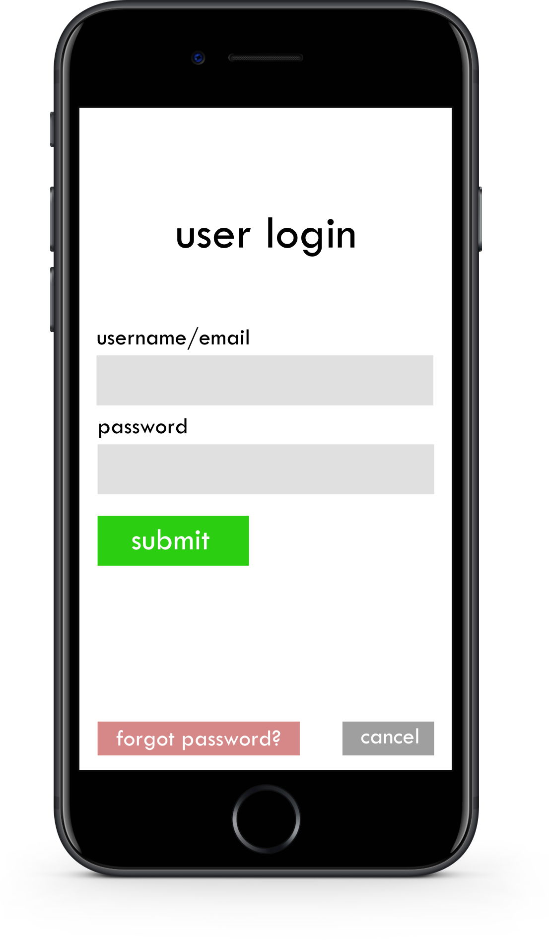
GUI MockUp - User Login
Login Form
Prevention of misuse

Slide 21
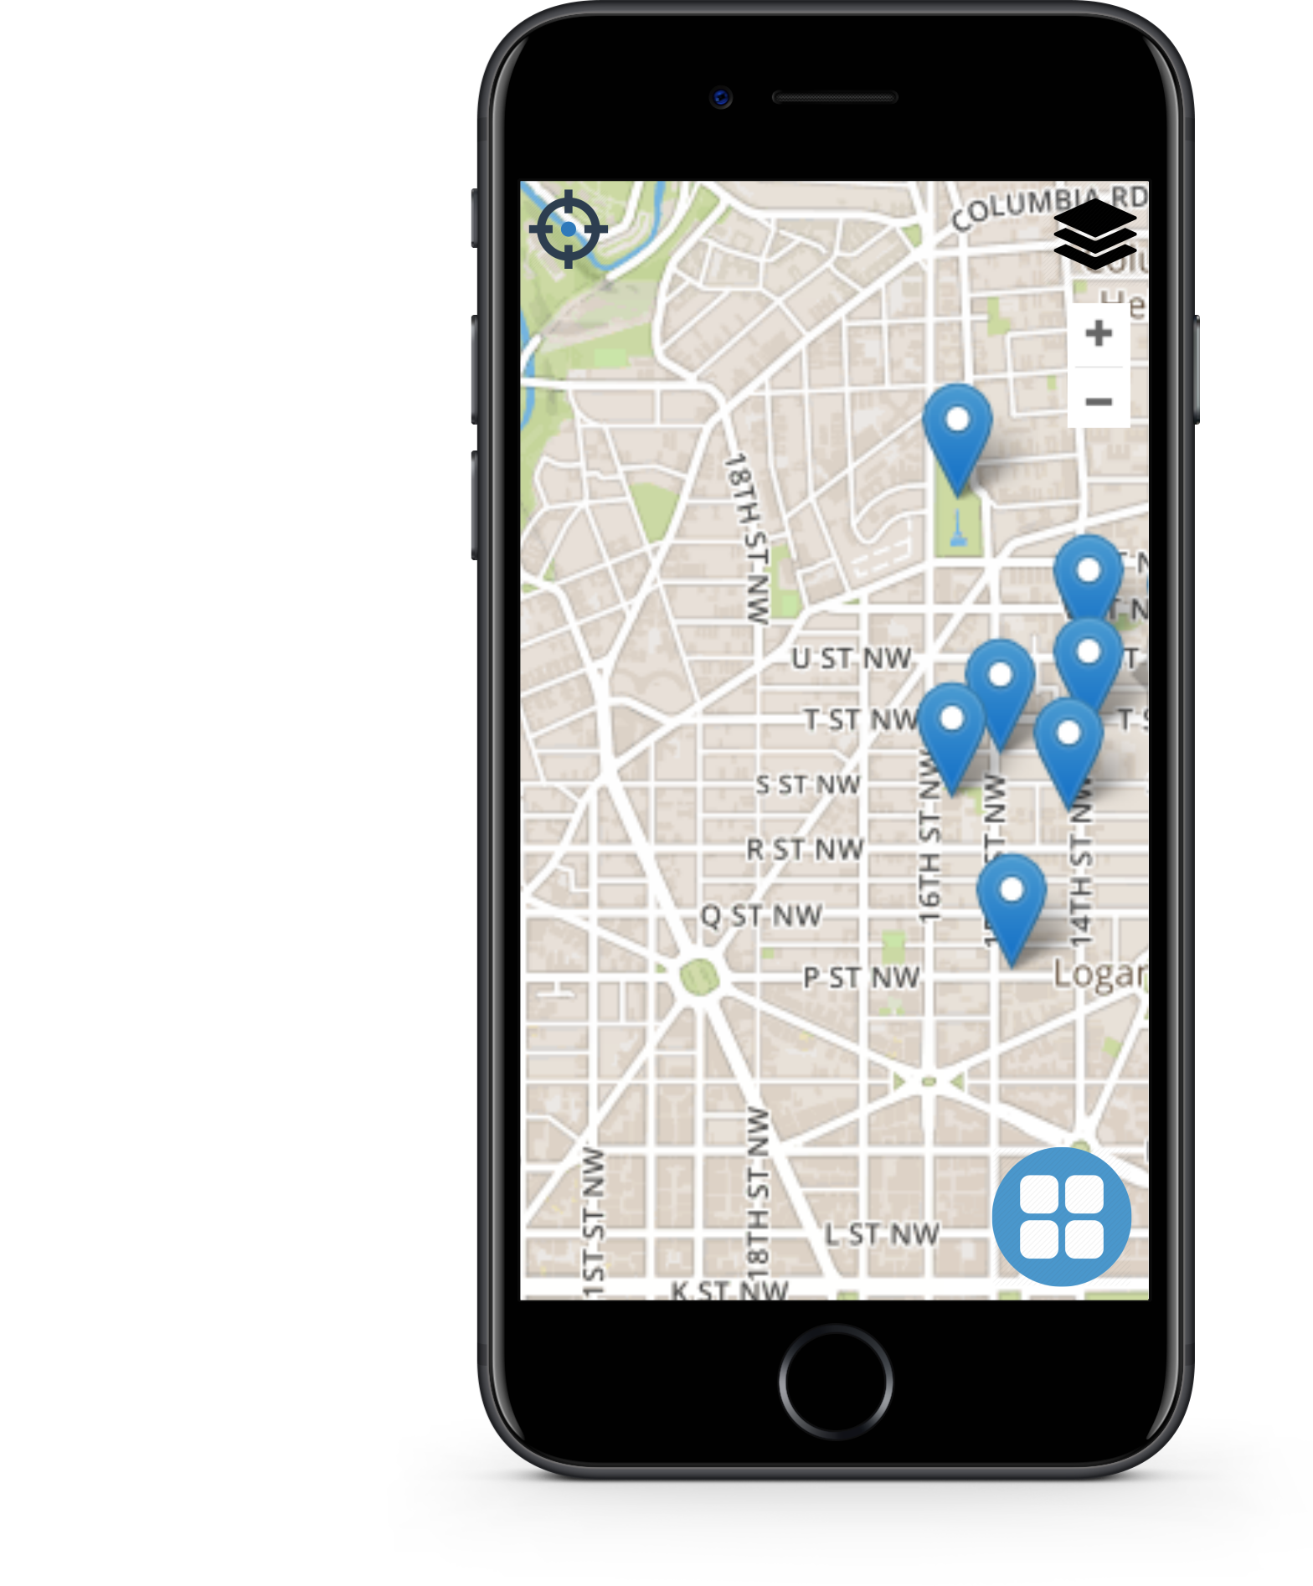
GUI MockUp
Orientation Map
Basemap
Layer Control
Localization
Menu
help
settings
Marker
Legend
Search Bar

Slide 22
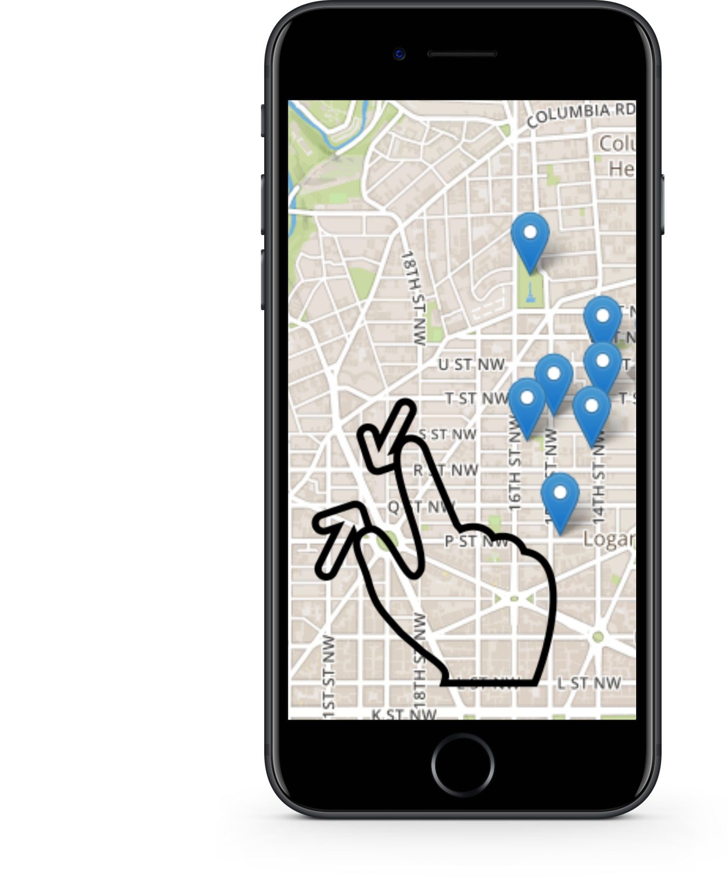

GUI MockUp - Orientation Map

Slide 23
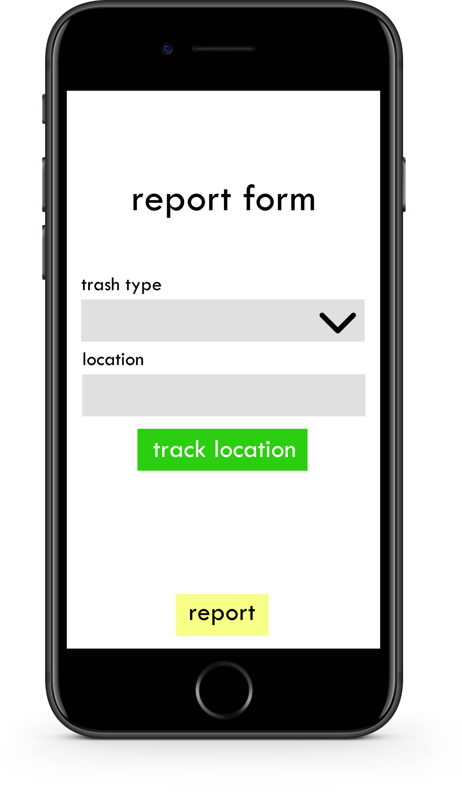
GUI MockUp - Report Form
Form
Trash type
Location tracking
(Photography)
Where?
How much?

Slide 24
GUI MockUp - Report Form
Form
Supermarket / User data with previous explained tables

Slide 25
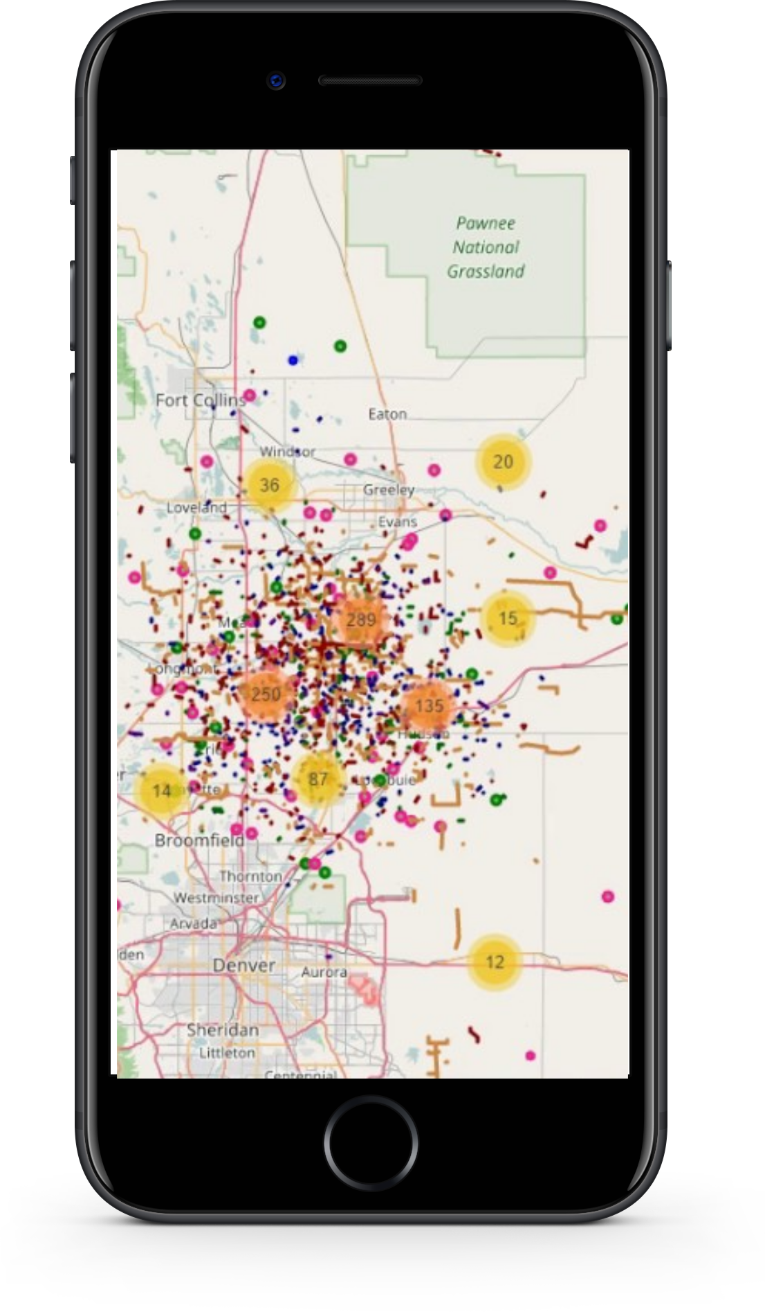
GUI MockUp - Report Tracking
Report Locations
Markers (types)
Heatmap (optional)
Added value: Where additional trash bins are needed

Slide 26




Libraries
jQuery
Mostly used JavaScript Framework
Simplifies JavaScript programming
Easy way to make websites dynamic
Bootstrap
Responsive design
Predefined, customizable html and css elements
Leaflet
Easy map integration
Openlayers
More functionality

Slide 28
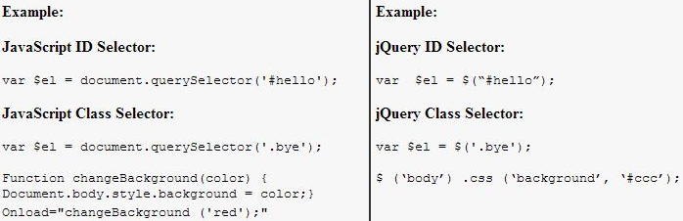
Easy to apply
Search-Engine optimized (readable text)
Saves time
Many plug-ins
Browser independently

Slide 30
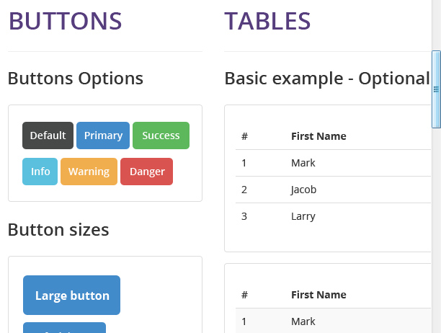
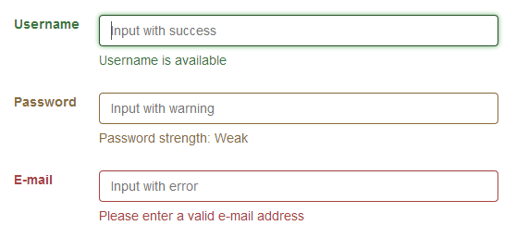
Advanced form set-up/validation
Modern Appearance
Responsive

Slide 32
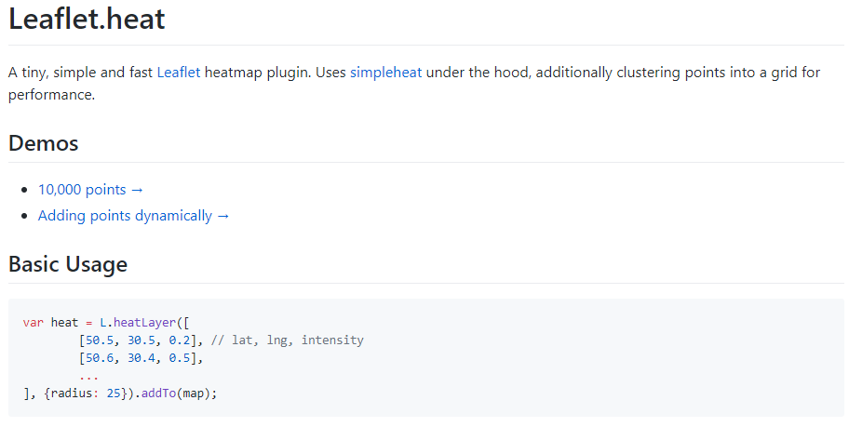

Slide 33
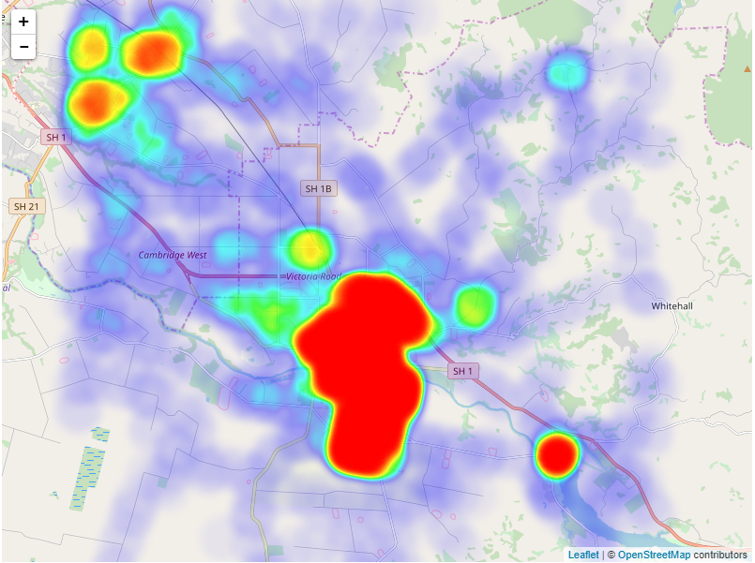

Slide 34
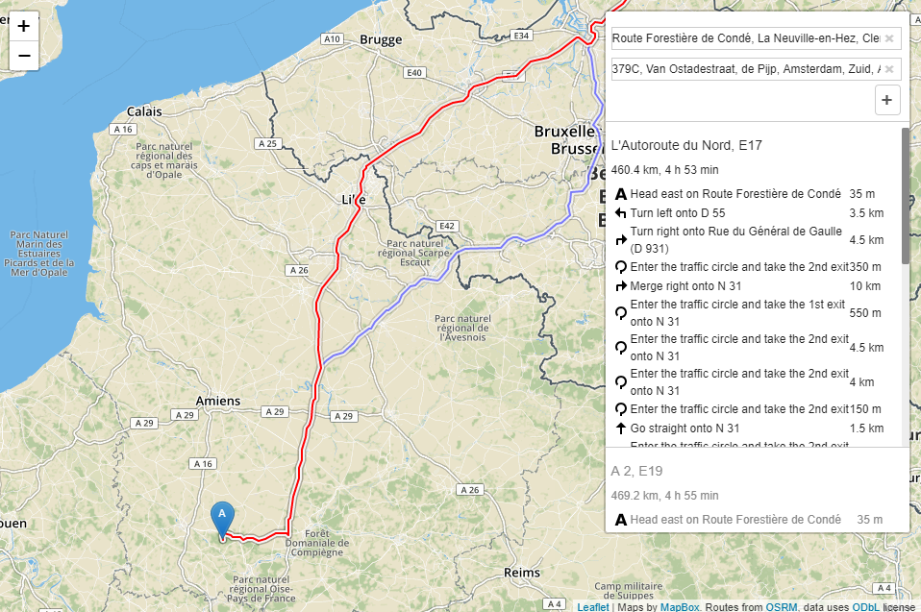

Slide 36
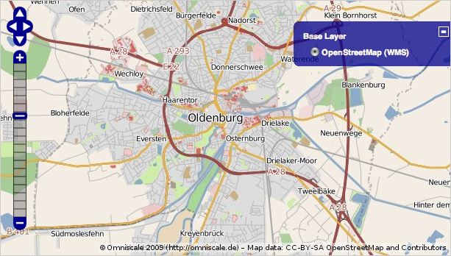
More “mature” than Leaflet
More Map Control features
Many customization possibilities
Suitable for complex maps/map functionalities

Slide 37
Leaflet or Openlayers?
What to do?
Functionality?
Functionality Expansion?

Slide 38
Project Management
Work division
It was decided that each member of the group would be responsible for a diff area, but of course there is a full support by the others if it would be necessary.
We keep in touch in our whatsapp group/during studies to work on this, so there is an updated situation for each step using the git opened for us by the Profesor..

Slide 39
Responsibility of group member
Yair Preiss: He is responsible for server site and DB
Oliver Hennhöfer: He is responsible for client site and GUI
Shaiful Islam: He is a project manager
Kristof : He is responsible for maintain license
Md Raqibul Islam: He also is project planner.

Slide 40

Tests responsibility to find errors - to self testing and look for errors
1.GitHub
2.BitBucket
3.GitLab
4.Coding
Today, repository management services are key components of collaborative software development.
Notes:
GitHub is a Git repository hosting service.GitHub is the standard nowadays not only as a source code repository but also as a place of collaboration for open-source projects if you are working with a large open source project that involves collaboration with several developers, GitHub could be your best choice.You’ll find a big and vibrant community on GitHub that can assist you in completing your project.

Slide 41

Why we use GitHub?
1.GitHub is the standard nowadays not only as a source code repository but also as a place of collaboration for open-source projects if you are working with a large open source project that involves collaboration with several developers, GitHub could be your best choice.
2.You’ll find a big and vibrant community on GitHub that can assist you in completing your project.pleting your project.
3.Track changes in your code across versions

Slide 42

General check ups with all group members that work is being done

Slide 43
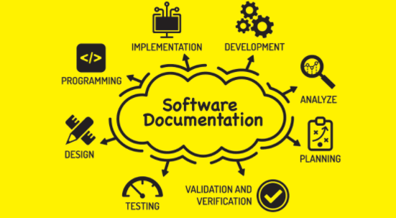
Documentation
Documentation is the important part of a project.So every group member is responsible for his area to make documentation.

Slide 44
General management
Each team member will report to me for each step done
Improvements of work techniques
Resolving upcoming challenges during project
Designing of work strategies
Taking in account the hesitations

Slide 45
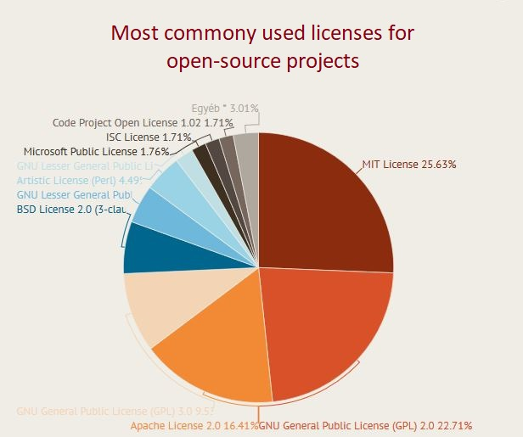
Licensing

Slide 46

Licensing: MIT Licence
Most popular one
Very few limitations on reuse
Easy to associate with other licenses
Users may redistribute Derivative Work
under different terms
No warranty is needed

Slide 47

Licensing: Apache 2.0
Can be used forever: doesn’t need to be renewed
Worldwide authority
Chance to extend the license
Patent claims can be used
Warranty can be placed on the program
Changes in the program’s code must be published

Slide 48

Licensing: GNU GPL 3.0
Warranty can be placed on the program
Patent claims can be used
Sublicense cannot be added
Source code must be published
As well as the state changes
Original software must be included

Slide 49
Project Development Process
Discussion
Task & Timeline
Development
Deployment
Requirement Analysis
Design
Testing

Slide 50

Project Planning Tools
open-source
standalone replacement for Microsoft Project.
written in the Java programming language,
License: Common public attribution license
Stable Release: 1.8.0 / May 29, 2018
Developer(s)): Marc O'Brien, Laurent Chrettieneau
Initial Release: August 19, 2012

Slide 51
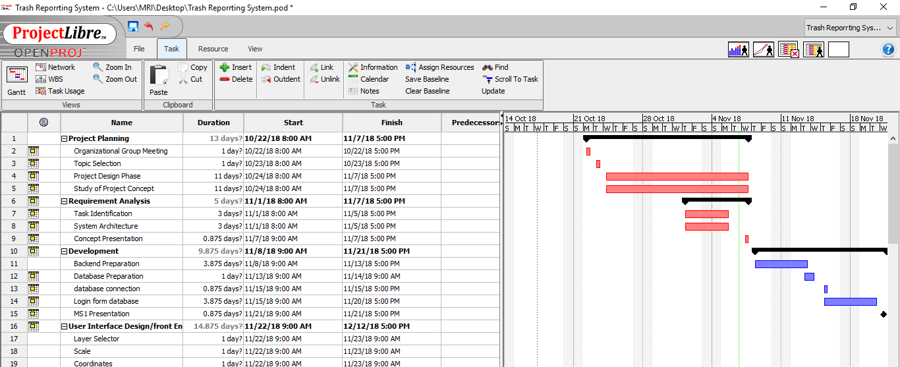

Slide 52
Project Risk
Potential Risk | Prevention | Reduce Impact | Probability 1 (low) - 5 (high) | Severity 1 (low) - 5 (high) | Risk Potential P x S
Team Member is unavailable (short term) | - | Increase working hours, redistribute work-load when team member is back | 3 | 2 | 6
Team Member is unavailable (long term) | - | Redistribute high priority/ depending tasks, lower overall workload, communicate with „clients“ | 1 | 5 | 5

Slide 53
Project Risk
Potential Risk | Prevention | Reduce Impact | Probability 1 (low) - 5 (high) | Severity 1 (low) - 5 (high) | Risk Potential P x S
Task takes longer than estimates | Plan carefully | Increase working hours, redistribute Workload equally | 5 | 1 | 5
Project is delayed | Plan carefully | Cut low priority tasks, increase working hours, communicate with „clients“ | 4 | 4 | 16

Slide 54
Thank You for your attention...

